Slide 1
The Fundamentals of Data Visualization
A Review of the Halloween Visualization Assignment
Created By: Jeffrey A. Shaffer Vice President, Unifund Adjunct Faculty, University of Cincinnati (513) 615-0001 | JeffreyShaffer@gmail.com @HighVizAbility
Notes:
Title Slide

Slide 2
Goals
By completing the course modules, students will:
Learn fundamental design choices through review of Halloween exercise
Learn data visualization best practices by compare and contrast through numerous examples
Discover some of the pitfalls in the analysis of the Halloween data set

Slide 3
Selected Samples: Halloween Assignment
Notes:
NOTE:
The purpose of this section is to learn the fundamentals of data visualization by reviewing many examples of work on the first assignment using the Halloween data set.

Slide 4
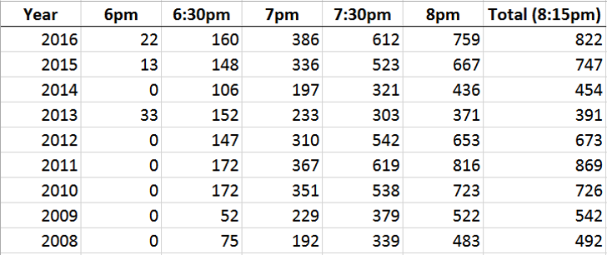
Halloween Data Set
Notes:
The data set for this week’s assignment was very simple. It only has data for a few years and it simply counts the trick-or-treaters in half hour increments. Most organizations have data like this. Counting widgets or sales over time, in some period, maybe days, weeks, quarters or months. In the following examples we will see how this data can be transformed with various calculations as well as additional data that can be appended to create interesting stories within this very simple data set.

Slide 5
[Instructors add examples from students here or at the end]
Notes:
Optional Examples can be added here and/or replace other examples throughout this deck.

Slide 6
Examples
from 2012

Slide 7
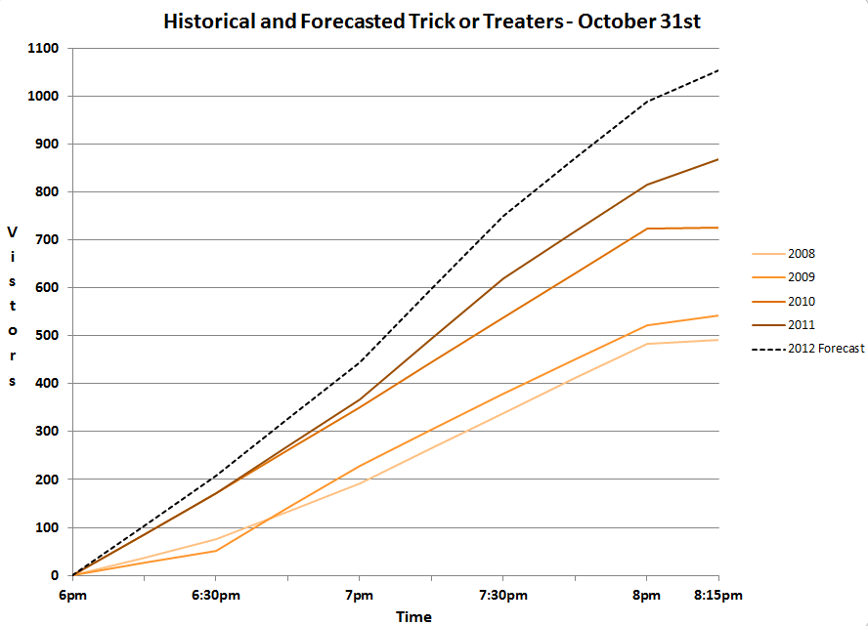
Notes:
In the early years, students only had 4 years of data. This is a common view of the data, especially when plotting the data in Excel. This is a cumulative view of the trick-or-treaters by year, with a forecast added for 2012.

Slide 8
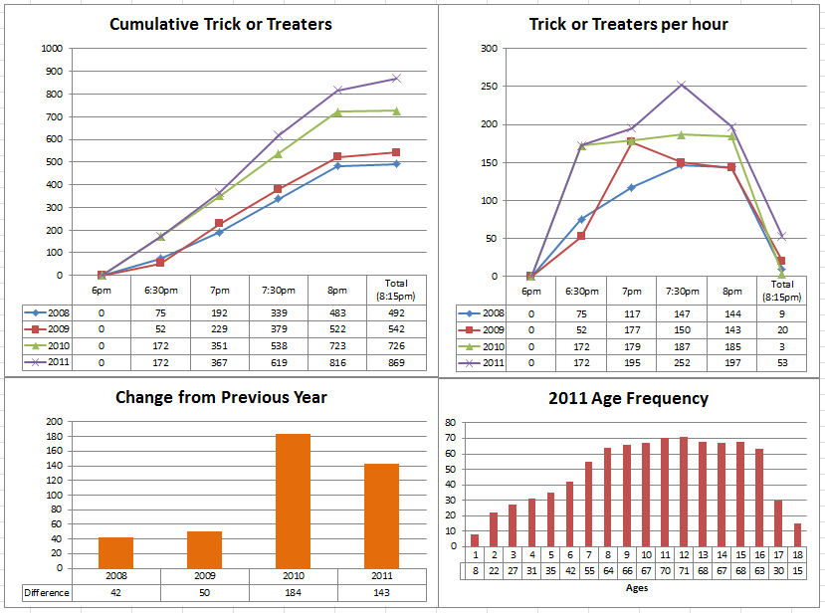
Notes:
In this example, the student has the cumulative view in the top left, the distribution in the top. Both of these charts use Excel defaults, which you will notice over and over in these examples. It’s good to remember that Microsoft Excel will do what it can to make your charts ugly while Tableau will do what it can to provide a cleaner chart by default.
The line charts at the top use different shapes as markers. In general, it is best to use small circles or dots so that the data points are precise. Using large shapes will over plot the points loosing precision. Also, if the shapes have multiple points, for example a square or X with four points on the edge, a triangle with three, or an asterisk with five, then precision can be overshadowed by these other points that surround the actual data point.
The bar chart on the bottom left is an example of a calculation. The student calculated the change year over year, which was not part of the original data set, but a simple calculation that was added which now provides new information.
The age frequency is an interesting look at the distribution of age of the trick-or-treaters, but no source for this data was provided.
Finally, notice the dark gridlines that are shown in narrow increments and the dark chart borders. This creates a bit of Moire effect as well as cluttering up the view of this dashboard. We will discuss this more later.

Slide 9
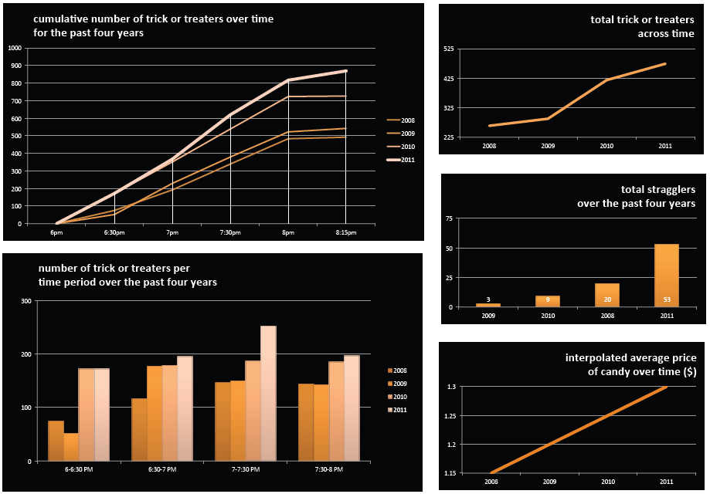
Notes:
This student created a similar view of the cumulative chart, this time with droplines. Notice these lines don’t add anything to the data though. The top right hand graph is the executive overview. The executive would likely want to know the total number, which is plotted over time. The only problem is that it’s the wrong numbers. If you recall from the data set, in 2011 there were 869 trick-or-treaters, but in this case the student only shows around 450.
The clustered bar chart is the first view we’ve seen with the time distribution shown by year. We will see other students do this, but it’s also possible to show year distribution by time.
The middle chart on the right side is another calculation. The student calculated how many trick-or-treaters came after 8pm, “the total stragglers”. This provides insight into the data showing that there were a large number of stragglers in 2011.
Finally, the average price of candy is plotted over time. Like the previous example, there is no source for this data and it seems to be plotted as a straight linear trend, so this is suspicious.

Slide 10
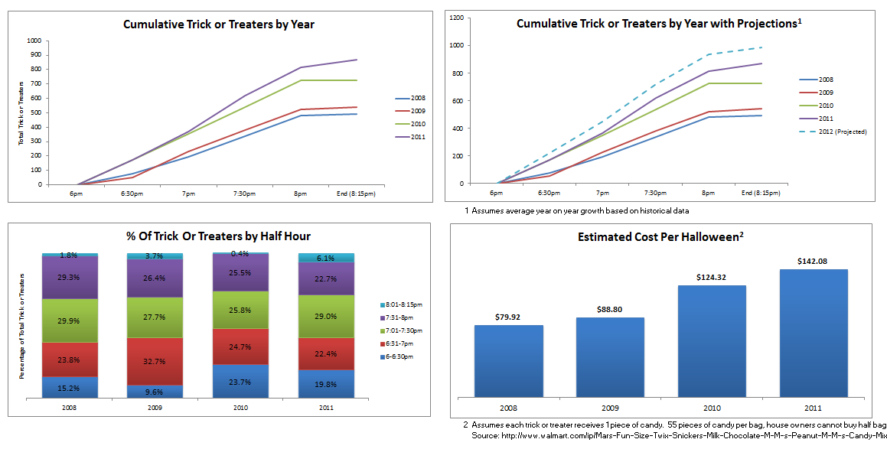
Notes:
Another dashboard showing the cumulative trick-or-treaters. Notice the top left and top right graphs are identical with the exception of a forecast line added on the top right. There is no reason to have both of these charts, so this could have been replaced with another chart or redesigned in some other way.
Stacked-bar charts can be very problematic, especially when they are over sliced. Notice how hard it is to compare the green or purple segments to each other. The only segment that allows for a precise quantitative comparison is the bottom segment in blue. This could be better unstacked as we saw in the previous example, so that each year would have a histogram showing the distribution of trick-or-treaters in each half hour segment.
The bottom right shows the estimated cost of candy for Halloween. This students did an excellent job researching the price of candy and listing that source on the data visualization.

Slide 11
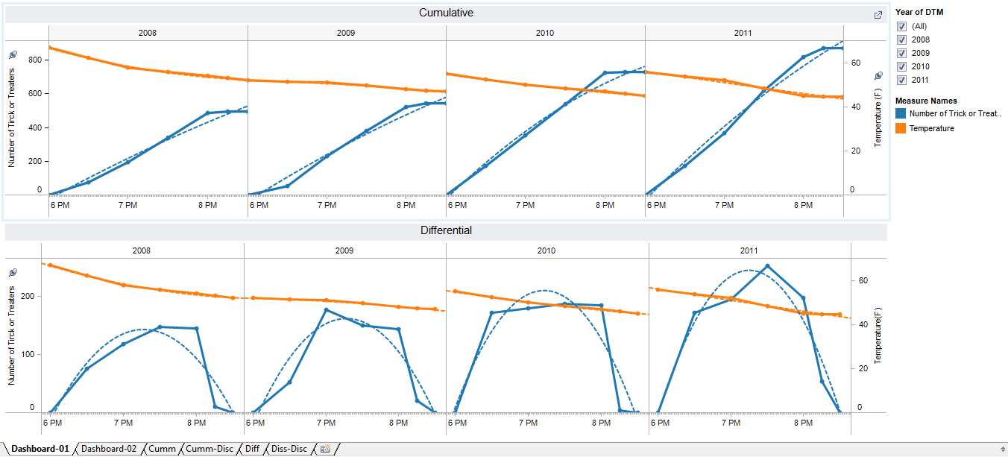
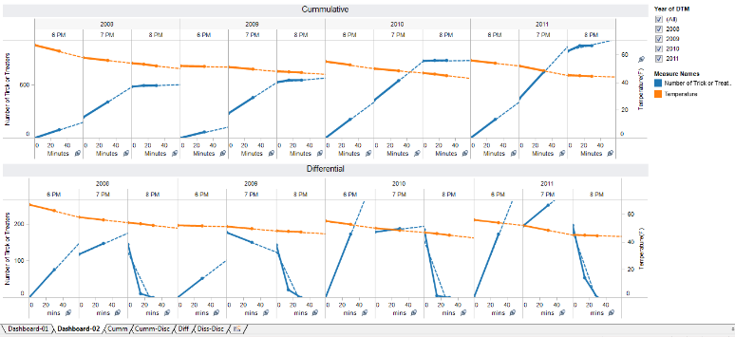
Notes:
How many students looked at weather data and compared that to the trick-or-treaters?
This example was done in Tableau. The student looked at the number of trick-or-treaters and appended the hourly temperature. We will explore this more in a few minutes.

Slide 12
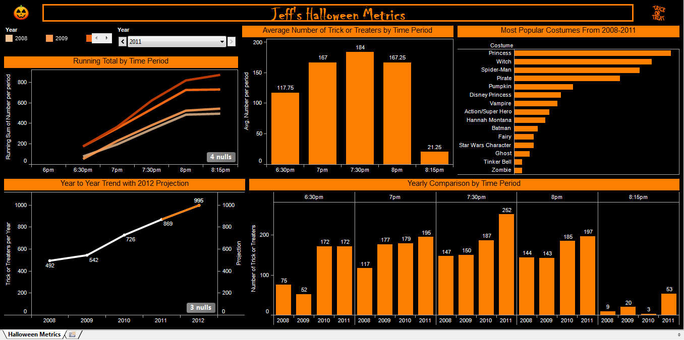
Notes:
This one is a Halloween Metrics dashboard. Notice the use of color and design elements on this one.
On the left side we see the cumulative view and the executive summary underneath it. In this case, the forecast is done in orange showing the forecast for 2012.
The top middle chart has another calculation from the data set, the average trick-or-treaters per time for all of the years.
The top right shows popular costumes, but again, there is no source data listed for this information.
Finally, along the bottom we see the first example of the year distribution shown by time.

Slide 13
Notes:
This example was done in Excel as a Halloween Planning Dashboard. We see the average trick-or-treaters by each time segment, along with the executive view. The third chart is a comparison of the trick-or-treaters with the Dow Jones Industrial average. This last one is a good example of correlation vs. causation because it’s unlikely that the kids or parents made their trick-or-treating decision based on how the stock market was doing. There might be some argument that economic conditions might affect the number of trick-or-treaters, but this would be better compared to something at the local level and not the Dow index.
There’s a number of interesting things on this one. For example, notice the question marks that are shown that users can click to get more information. Also, the Knowledge and Recommendation sections are great for providing the user with a quick summary of what is learned from this data and what the recommendations are as a result. It provides an excellent annotation layer.
There are a number of design issues with this dashboard though. Let’s examine a few things, mostly minor changes that we can make to clean this visualization up and declutter it.
1.) there is rotated text on the x-axis of the first chart. This is a result of 6:00 having the 00 and Excel auto formatting the labels to make them fit.
2.) notice the x-axis from the first chart drops down to the second chart and then again to the third chart. They are all positioned differently.
3.) the legends take up large amounts of space on the right of each graph. Some of them are repeated with the title, for example “Average visitors per timeframe” and “total visitors in a given year”
4.) the markers on the line chart are big on one chart, but smaller on the other.
5.) the gridlines are dark and in small increments.
Let’s see if we can address these points to create a better visualization.

Slide 14
Notes:
In this redesign the x-axis is straight across, it avoids the rotated text and it utilizes sub-titles to avoid the legends taking up so much space. The gridlines have been muted and spaced in larger increments and the dots on the line chart are smaller and consistent on both line charts. There’s certainly more we could do to clean this up even further, but let’s look at some more examples.

Slide 15
Halloween Chart Assignment Samples
Notes:
In this one we see the Excel default colors again and some very familiar views of the data.
The bottom left hand chart shows two donut charts with the method of collecting candy. While this was an interesting idea, there is no source for this data and it’s a very difficult view of that data. Comparing average candy price on the outside donut against the pounds of candy on the inside is impossible. This could be better as a clustered bar, and that is assuming that the data being compared is an accurate comparison to begin with.
There is an interesting calculation that the student created, which is the “Return on Candy Investment” or ROCI. This is a good example of translating the data into a financial impact, but in this case, the conclusion is that the homeowner should “buy the candy he likes and turn the lights out”. That might make the most financial sense, but it misses the point of Halloween, so it’s not really a valid conclusion.
Finally, notice the gradient color that is used on the bar charts. The color does not add anything to the data and is potentially confusing to a reader. They may be left wondering, why is the bar going from yellow to red to show this data?

Slide 16
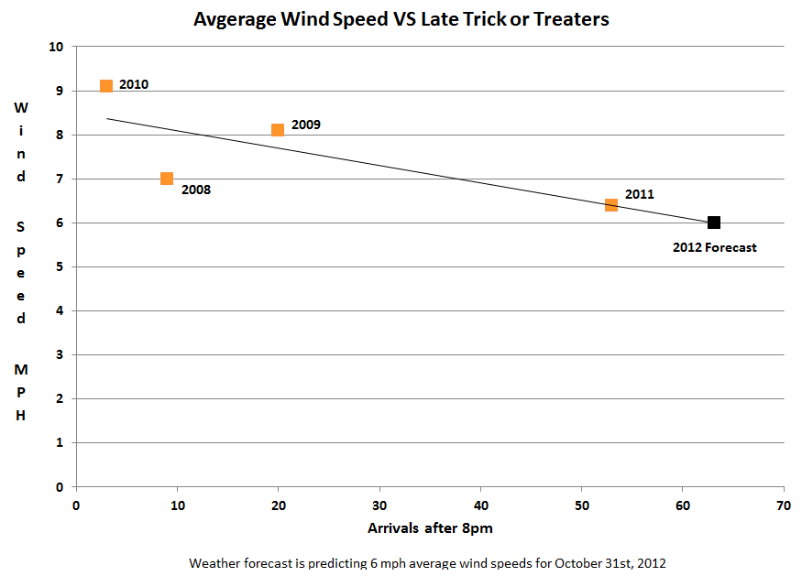
Notes:
This is another example of using weather data, in this case the Wind Speed compared to the stragglers. This student misspelled the title of the viz and decided to rotated the text on the y-axis. In most cultures people read left to right. There has been research done about rotating text. The more text is rotated, the longer it takes for readers to read it and the more errors they will have.

Slide 17
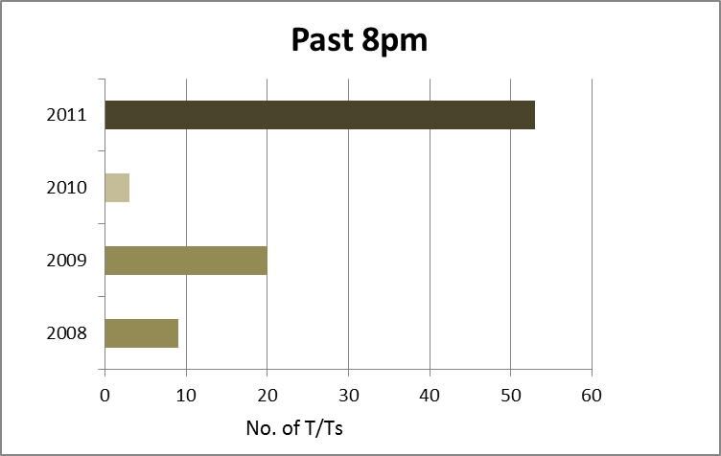
Notes:
This is another example of the stragglers past 8pm. In this case, time would be better on the x-axis so that we can see the trend going up to 2011.

Slide 18
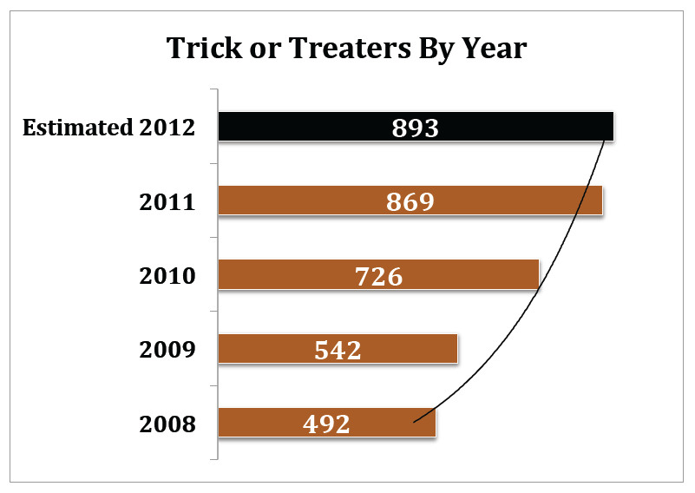
Notes:
And another example where time is rotated. In general, bar charts can be shown vertically or horizontally, but if trying to show a trend over time it is better to keep time on the x-axis. In general, readers expect to see time with cave men on the left going to space men on the right.

Slide 19
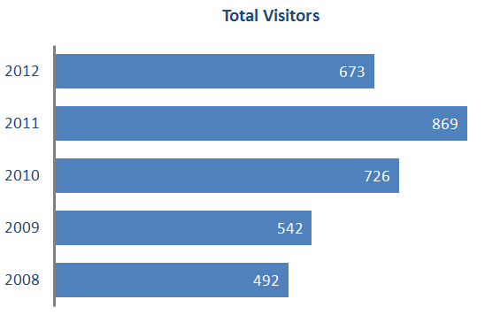
Keep Time on x-axis!
Notes:
This is the actual data for those years. Notice that it’s hard to see the trend up to 2011 and then the drop in 2012.

Slide 20
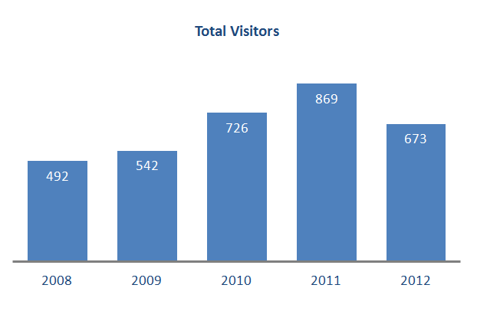
Keep Time on x-axis!
Notes:
Simply rotating the chart and keeping time on the x-axis allows us to see that trend up followed by the drop.

Slide 21
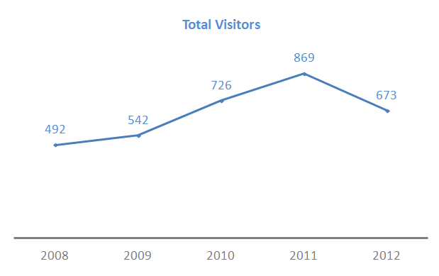
Line Charts for Time Series
(Usually a good option)
Notes:
A line chart can be a great option for showing a trend over time. Also, a line chart does not have to start the axis at zero because it does not encode length from a baseline, so there are some additional benefits.

Slide 22
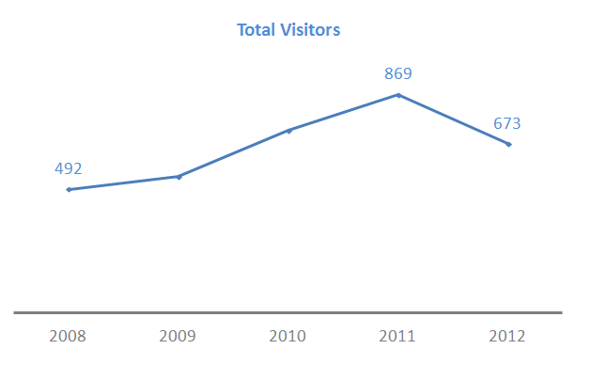
Line Charts for Time Series
(Usually a good option)
Notes:
Don’t feel compelled to label every point on the line chart. If there are lots of lines or lots of points, consider labelling the first and last points and then other points that are meaningful, for example the highest or lowest point. Notice we get the same information with just 3 labels. The trend goes up to 869 in 2011 and then drops in 2012. If the other points are still important, but not important enough to label, then consider a y-axis with labels and light grid lines to add additional context to those unlabeled points.

Slide 23
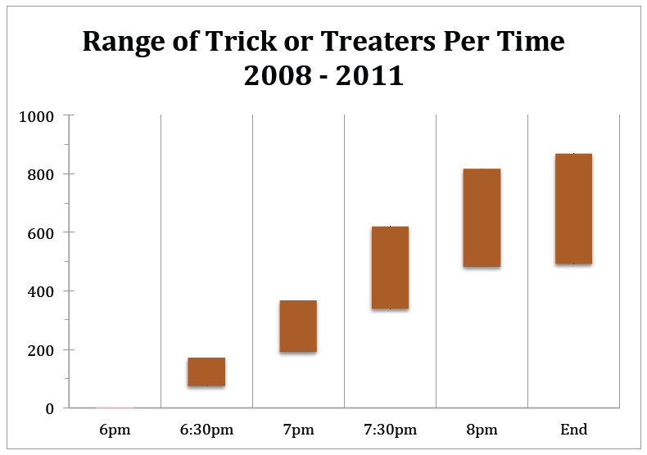
Notes:
This is a great analysis of the data showing yet another calculation that can be used in the data. The bars plot the minimum number and maximum number of trick-or-treaters in each time segment. The result is a range of low to high for each half-hour segment.

Slide 24
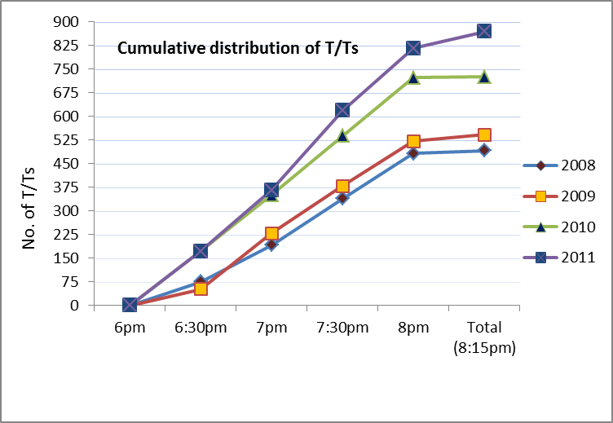
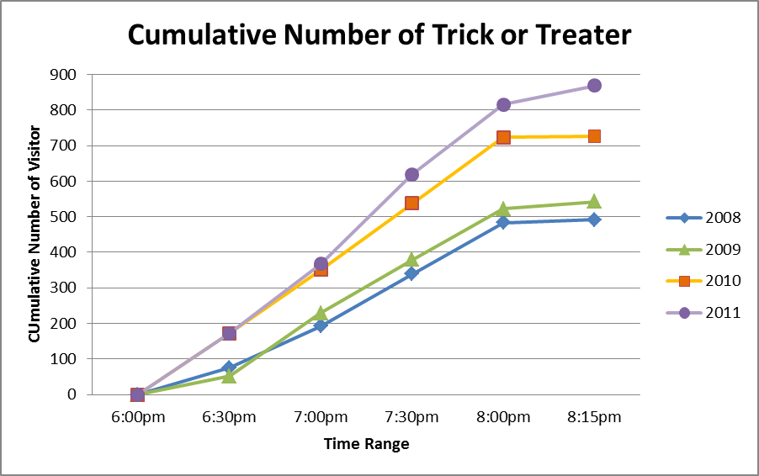
Avoid Excel Defaults
Person A
Person B
Notes:
As mentioned earlier, it’s best to avoid Excel defaults. Notice how the students plotted very similar charts using various default formatting options in Excel. Person A and Person B.

Slide 25
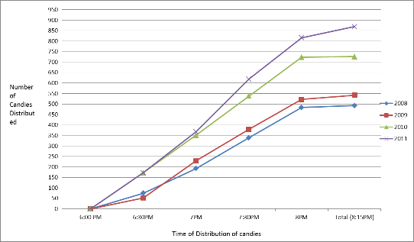
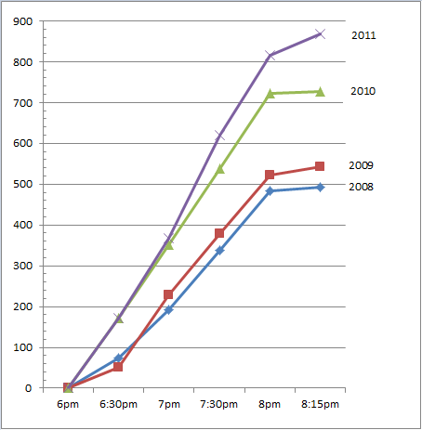
Avoid Excel Defaults
Person C
Person D
Notes:
Person C and Person D, with the standard purple, green, red and blue colors of Excel

Slide 26
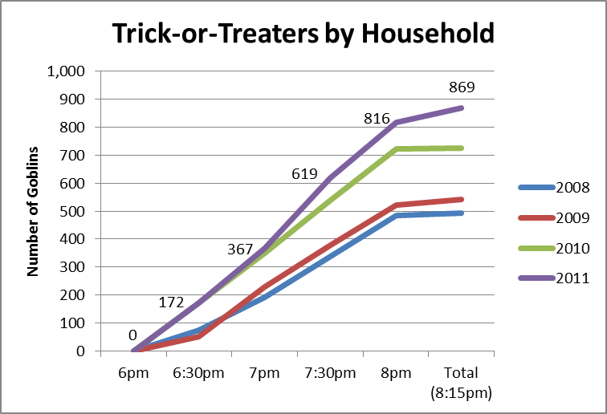
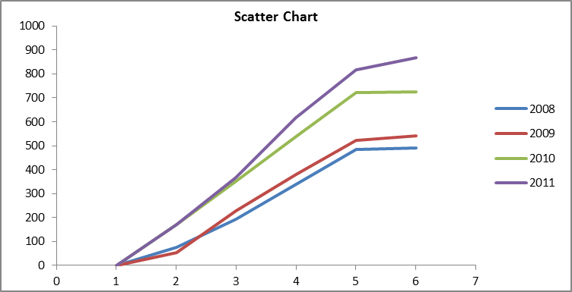
Avoid Excel Defaults
Person E
Person F
Notes:
Person E and F.

Slide 27
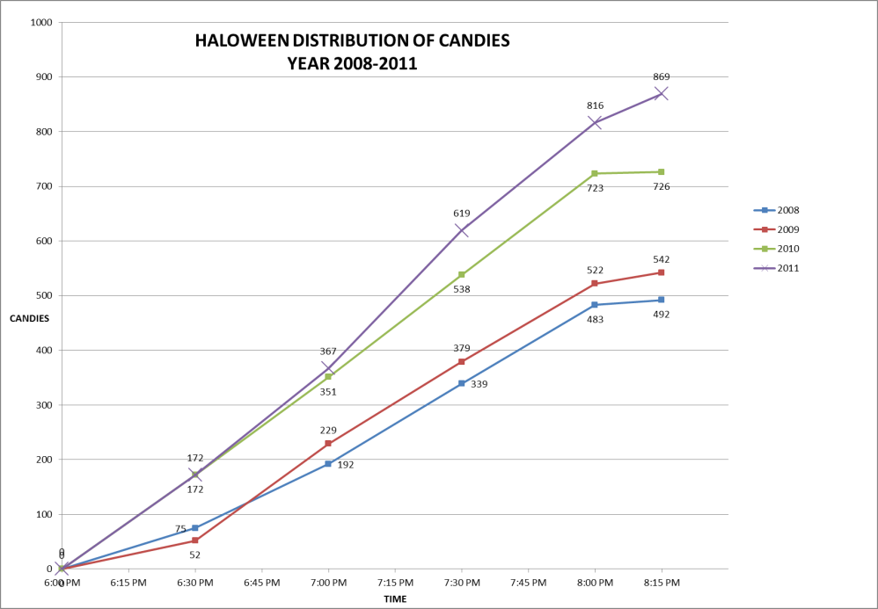
Avoid Excel Defaults
Person G
Notes:
And person G.

Slide 28
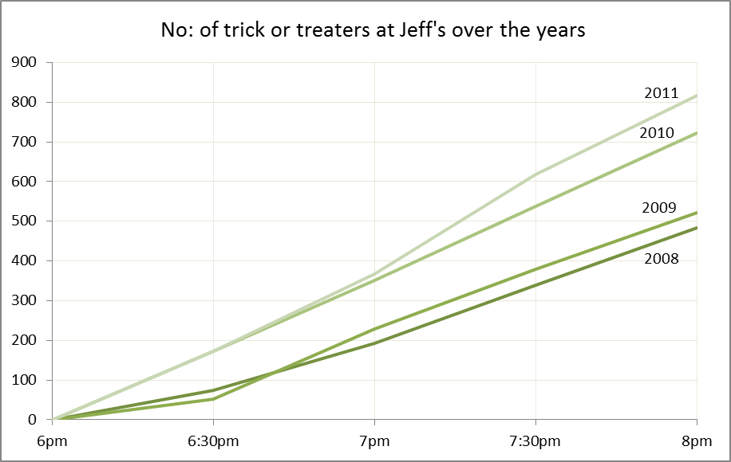
Avoid Excel Defaults
Sigh of Relief
Notes:
After seeing those, it’s a sigh of relief to see something a bit different.

Slide 29
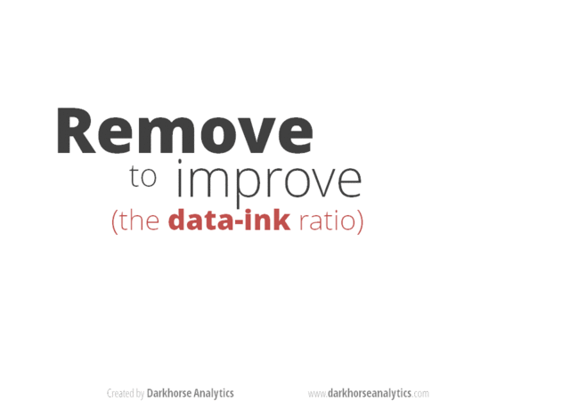
Notes:
[Animated GIF from darkhorseanalytics.com]

Slide 30
Examples from 2013-2015
Notes:
In addition to the thousands of students that have used this data set as part of their class, this data set has been used across the world for corporate training as well. It was used for a number of years at KPMG, one of the big four accounting firms, as part of their internal data visualization training. There have been hundreds of KPMG analyst, directors and managers work on this, so it’s easy to say that millions of dollars of time has gone into analyzing the trick-or-treaters here.

Slide 31
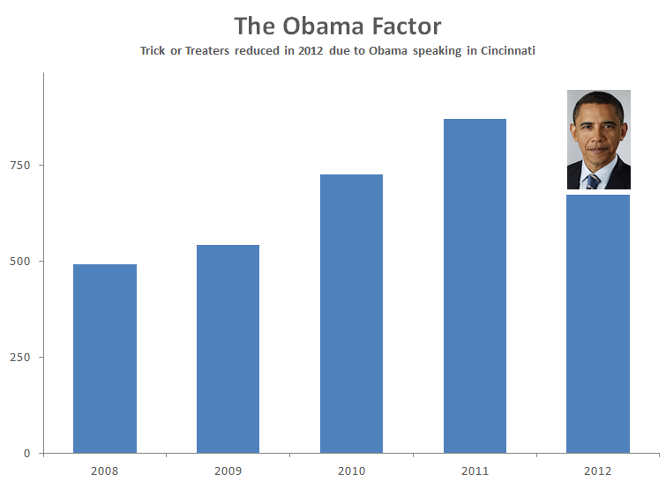
Notes:
One of the partners at KPMG decided to “Blame it on Obama”. Apparently it was his fault that the trick-or-treater count was down in 2012. The reason presented was that President Obama was scheduled to speak on Halloween in 2012 at the University of Cincinnati as the theory was that people would be attending that event. The viz shows the trick-or-treaters lost as a number equal to his head on the bar chart. This theory was later debunked as the speaking event was cancelled and President Obama did not come to Cincinnati that evening.

Slide 32
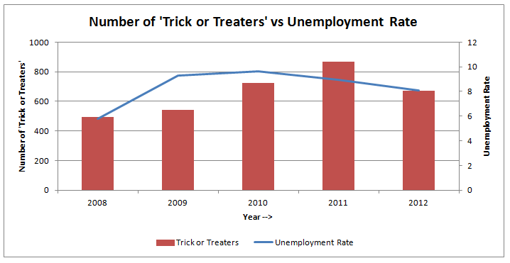
Notes:
This student looked at the unemployment rate versus the trick-or-treaters. Another example similar to the Dow Jones comparison.

Slide 33
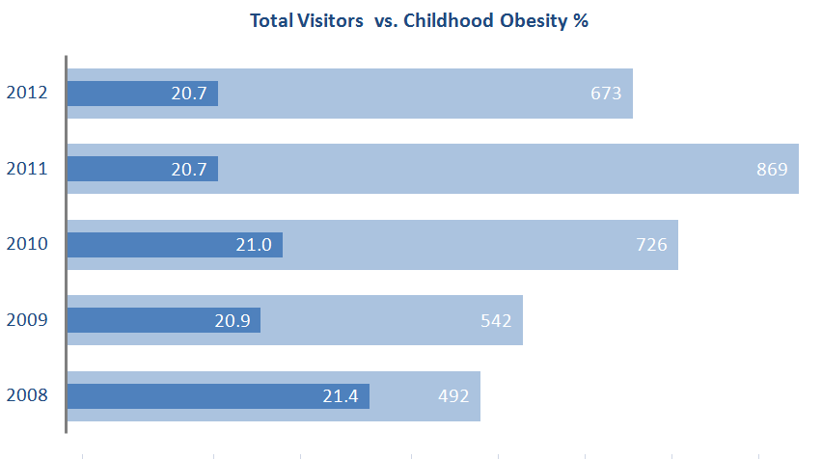
Notes:
This student looked at Child Obesity vs. the total trick-or-treaters. This is another example where time would be better on the x-axis to show the trend over time. However, there are bigger issues here. Take a close look at the bars. What’s the problem?
[give the students a minute to examine and figure this out]
This one is a bit tricky, because the bars for the trick-or-treaters is plotted correctly, but the Childhood Obesity is not. The axis for the Obesity % does not start at zero. Notice the VERY small differences in the data, but the large differences in the length of the bars.
When encoding data using length or height it is imperative that the axis begins at zero otherwise the comparison will be distorted and potentially deceiving.
In addition, this analysis is flawed. The student is visualizing this as if to say “Fat kids like Candy”. The data shows no relationship to this at all, in fact, the lowest count in 2008 has the highest child obesity, but the difference in the Obesity % is so small year to year that it’s basically flat, decreasing slightly.
Overall this is a flawed analysis that is poorly visualized.

Slide 34
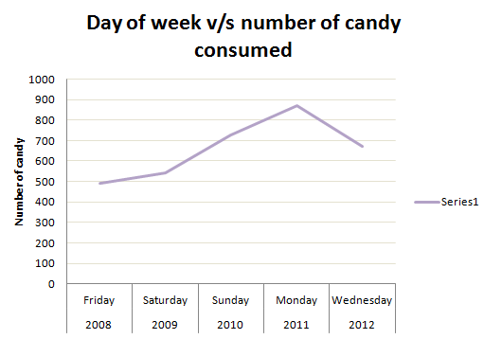
Notes:
This example shows the “day of week”, which could be an interesting comparison as more years of data are gathered. Notice Excel defaulting the name of the series to “Series 1”, which is not helpful.

Slide 35
Notes:
Many of you looked at weather, specifically the average temperature. Be very careful with averages. In this case, the average daily temperature is showing that 2009 was the warmest year. Let’s examine the data for the temperature.

Slide 36
Temperature Date
Notes:
Average is just one measure of central tendency, along with median and mode. It’s always a good idea to examine the data, looking at the min and max and the distribution of the data used to calculate the average. Notice 2008 with the minimum of 30 degrees and a maximum of 72 degrees (Fahrenheit).

Slide 37
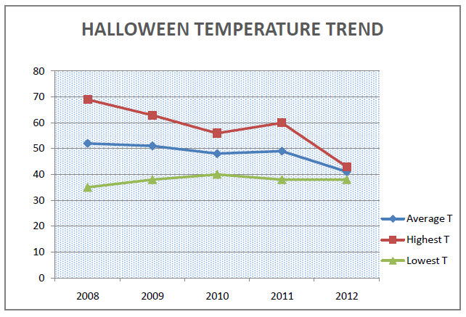
Notes:
Here is the range for each of the years. Notice the wide range of 2008. The problem is that when using the daily average students came to the conclusion that 2009 was the warmest year, when in fact, if we look at the hourly temperature for the time during trick-or-treating hours we will see a completing different picture of the data.

Slide 38
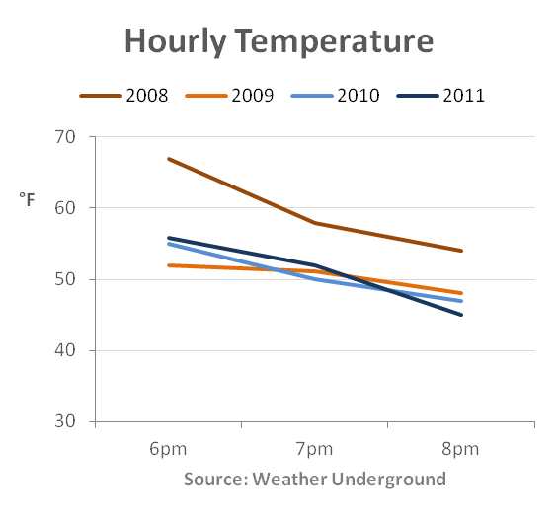
Notes:
In 2008, the temperature at the time of trick-or-treating was almost 70 degrees making 2008 the warmest year by far. Not only was 2009 not the warmest year, it actually started as the coldest year. By using the daily average we distort the data and tell a completely inaccurate story.

Slide 39
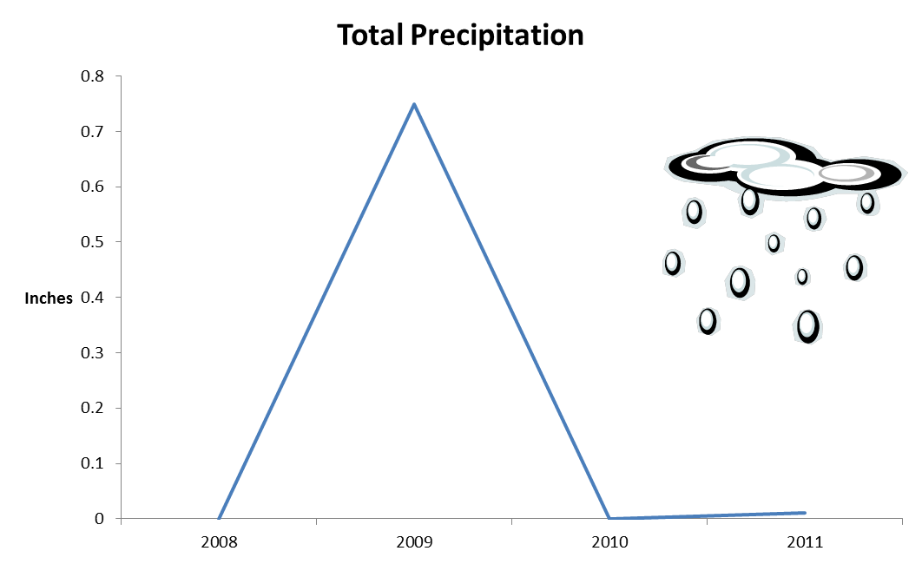
Notes:
This student looked at precipitation. As we discussed earlier, a line chart is a great chart to show a tend over time, but in this case we don’t actually have a trend over time. We have a single point that has precipitation and the others are all zero or near zero.

Slide 40
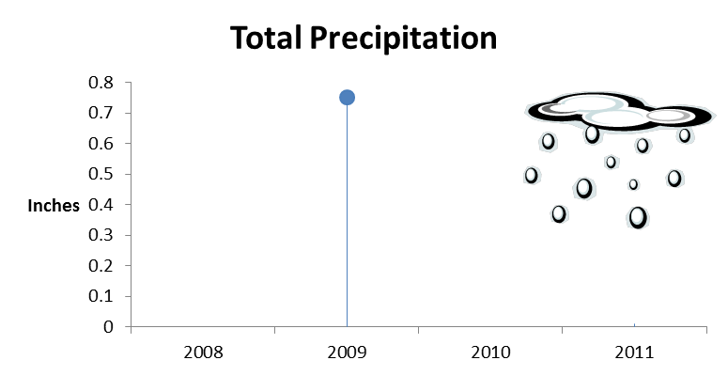
Notes:
In this case, why not just plot the single point, using a lollipop chart that looks a bit like a raindrop. Notice there are 9 labels on the y-axis axis to help the reader approximate where 1 point of data is on the line chart. So let’s get rid of those and just label the one point.

Slide 41
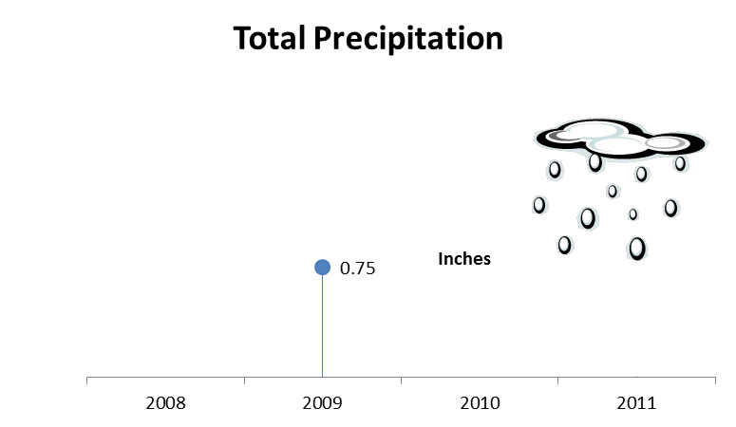
Notes:
Now the point has a single label which give us the exact number. Much simpler and cleaner.

Slide 42
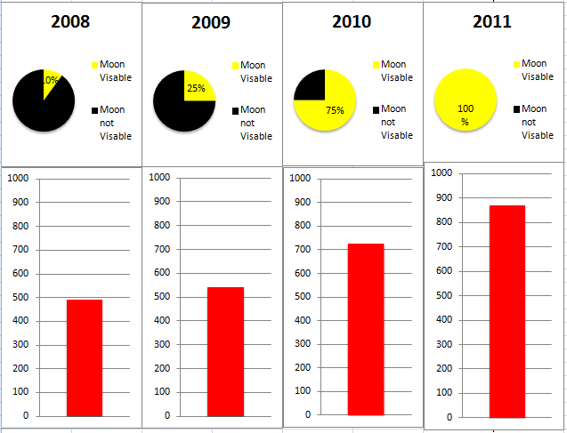
Notes:
This student decided to use pie charts to show the phase of the moon. We see 10% visible, 25%, 75% and 100%.
1.) Notice the color legend repeating
2.) there are 11 y-axis labels over 4 bars, totaling 44 labels to give us an approximate idea of the value of 4 bars.
3.) look closely at the boxes around the bar charts. They are not aligned. The first two are lower than the fourth and the third one seems smaller.
We will talk more about the difficulty with pie charts, but in this case there are only 2 slices. From a design standpoint, we have to ask ourselves, if we want to show the phases of the moon, then why not just show the phases of the moon instead of pie charts?

Slide 43
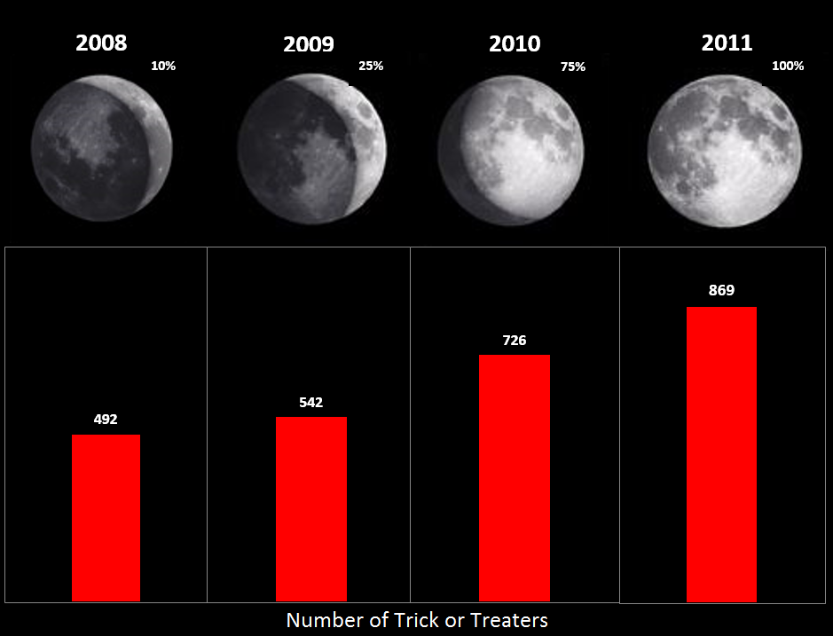
Notes:
NEED TO FIX IMAGE (moon and right border)
This redesign shows images of the moon from Wikipedia and four bar charts, each with a data label showing the exact number of trick-or-treaters. Overall a much simpler and cleaner design.

Slide 44
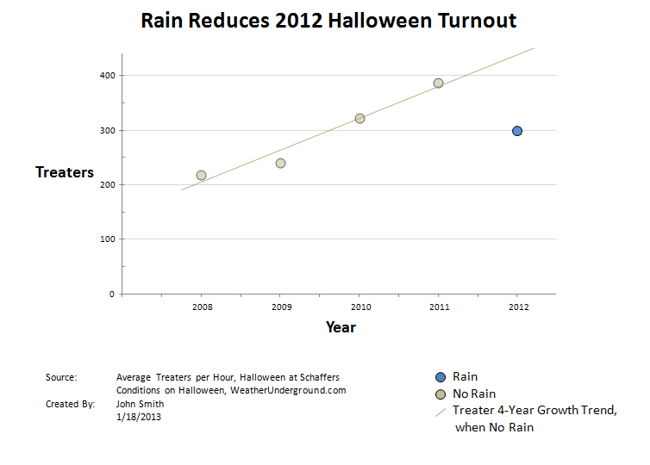
Notes:
This one was very well done. The student looked at the turnout for trick-or-treaters compared to rain. A very simple use of color with rain in blue. Dot encode precise values. Time is plotted on the x-axis, the gridlines are muted and in increments of 100. He also avoided rotated text with the axis label, cited his source for the data and listed the author and date of the viz.

Slide 45
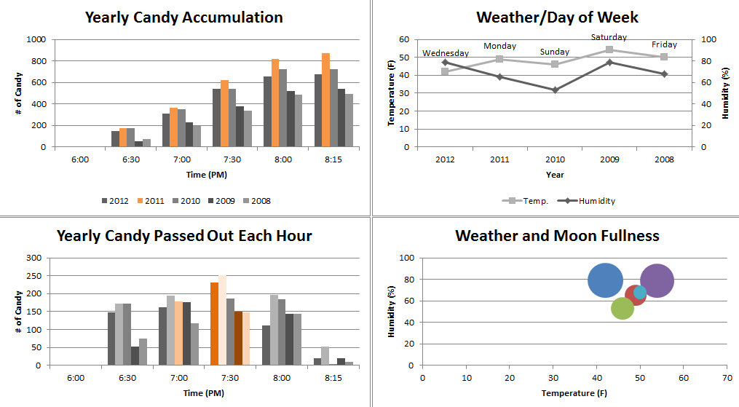
Notes:
This dashboard shows the # of candies by year within time.
The chart in the top right hand corner shows temperature and humidity with the day of week, but what’s wrong with this line chart?
[ask students]
The issue here is that time is plotted backwards on the x-axis.
This student also showed the phases of the moon, but in this case used the size of the circles on the scatter plot.

Slide 46
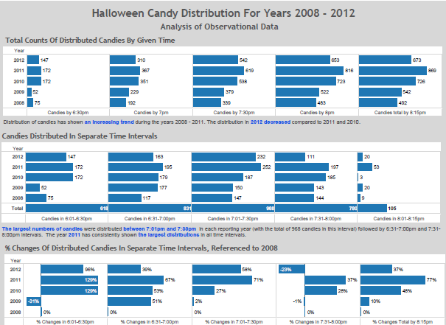
Notes:
This dashboard shows various distributions by year and time. The chart on the bottom row shows a new calculation that we haven’t seen before. This comparisons shows the % change of distributed candies referenced to the first year of data collection in 2008. Another example of table calculations that can be done to provide additional information.

Slide 47
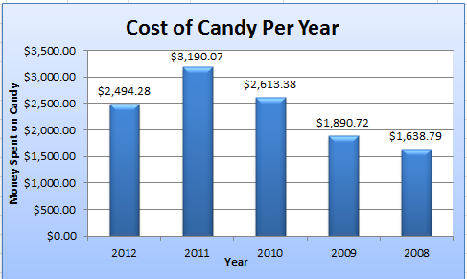
Notes:
Now it’s your turn. What are the issues with this chart?
[give the students time to discuss]
Students will typically get:
1.) time backwards on the x-axis
2.) rotated text
3.) y-axis labels don’t need decimal places and with the data labels aren’t necessary at all.
4.) heavy gridlines in small increments
The biggest issue though is the data that is being plotted. If the students don’t catch this, you can tell them to think about the data.
Is it reasonable to think that the homeowner spend $3,190.07 on Halloween? That’s the price of a used car. Halloween can be expensive with the large number of trick-or-treaters, but these numbers are off by a factor of 10.

Slide 48
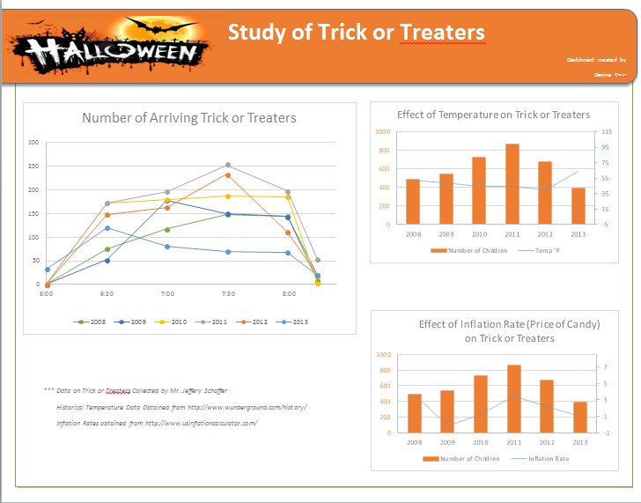
Notes:
This student created a beautiful dashboard. Look at the great use of color and the design elements. It is very clean, the data source and author are listed.

Slide 49
Examples from 2016
Notes:
Jumping to some examples of students from 2016.

Slide 50
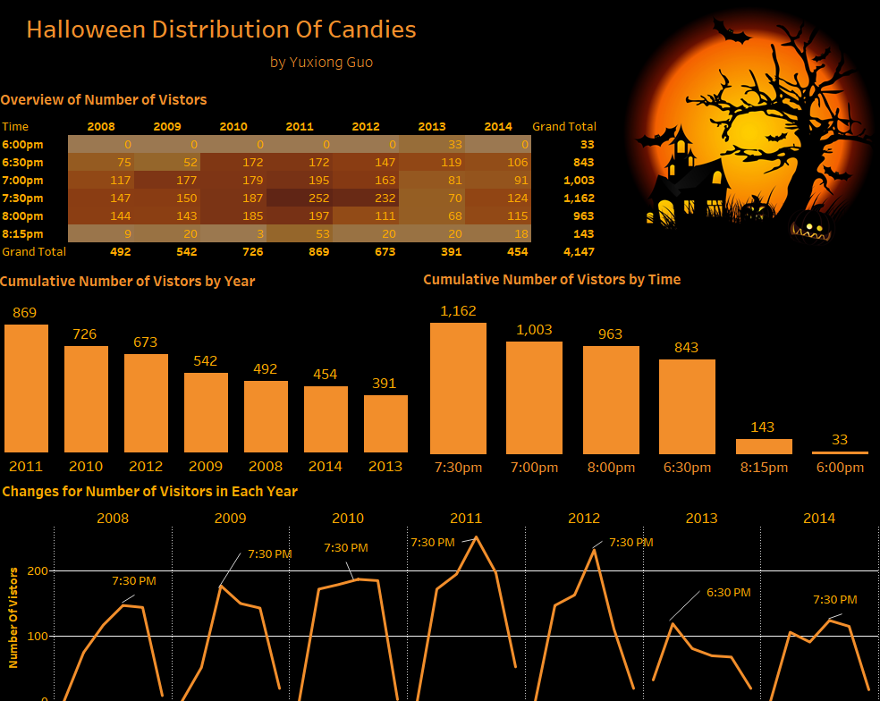
Notes:
This student redesigned their visualization, using a highlight table to show times that had heavier trick-or-treater counts. Notice the use of color and the design elements.

Slide 51
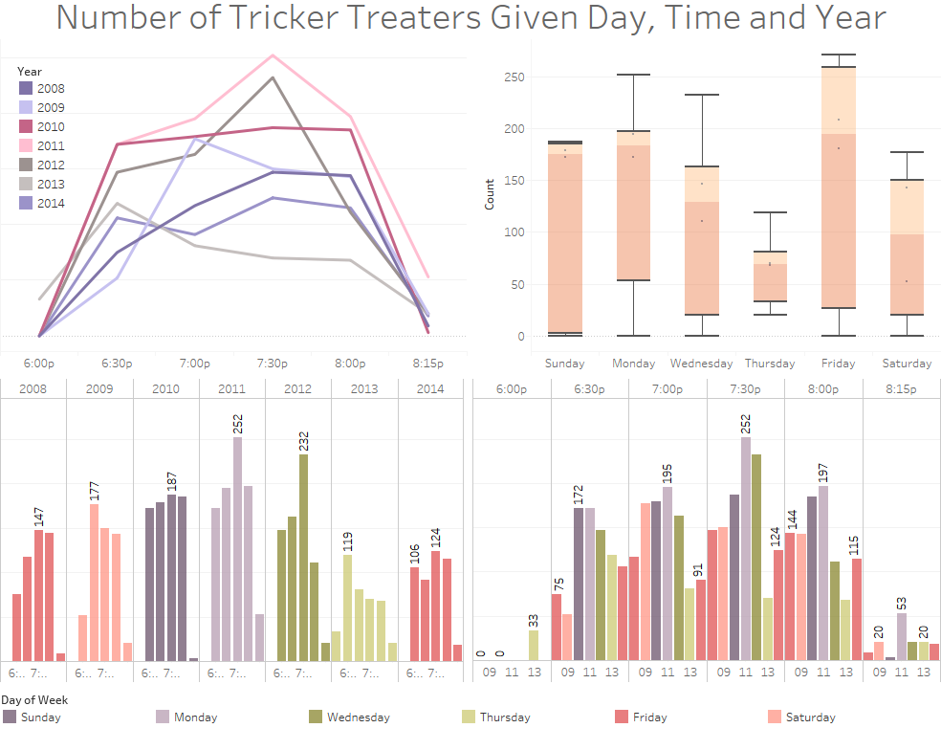
Notes:
This student used a box plot to show the distribution of years for each weekday. In this case, a range bar showing the minimum and maximum would be a better view of this data, especially since there are not that many data points to analyze the weekday.

Slide 52
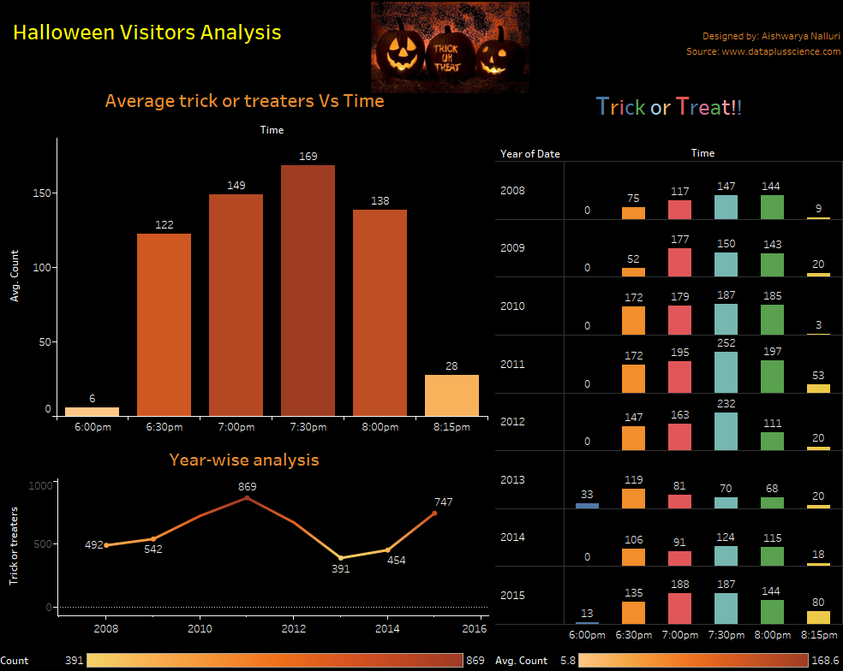
Notes:
This dashboard shows the average trick-or-treaters for all years. The chart on the right side shows an example of small multiples, comparing the time in each year.

Slide 53
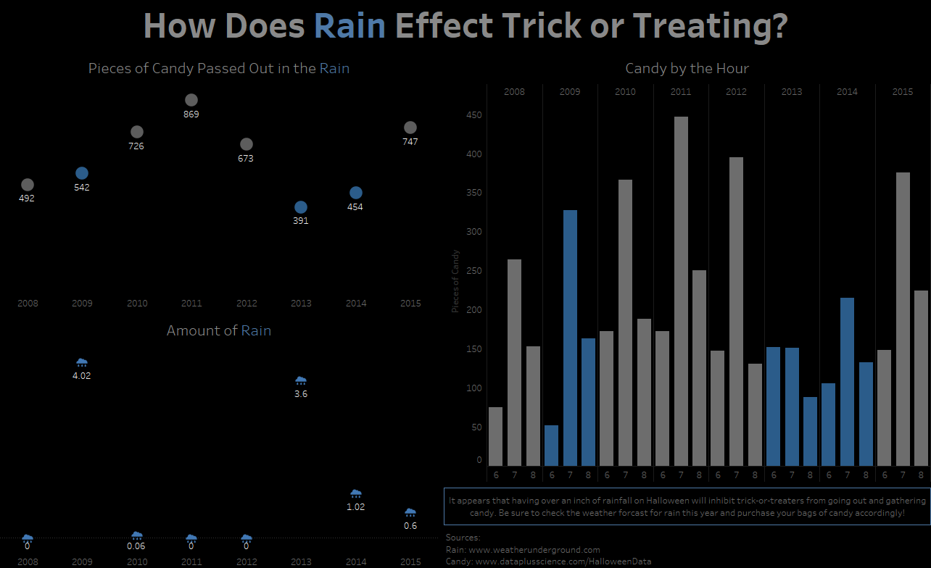
Notes:
This viz has some great design elements. Notice the use of color and how “Rain” is blue in the title. This acts as the color legend and we can quickly see where the data is highlighted in blue throughout the viz. The dot plot could use a line to help show the trend over time. The rain clouds are similar to the lollipop example we saw earlier.

Slide 54
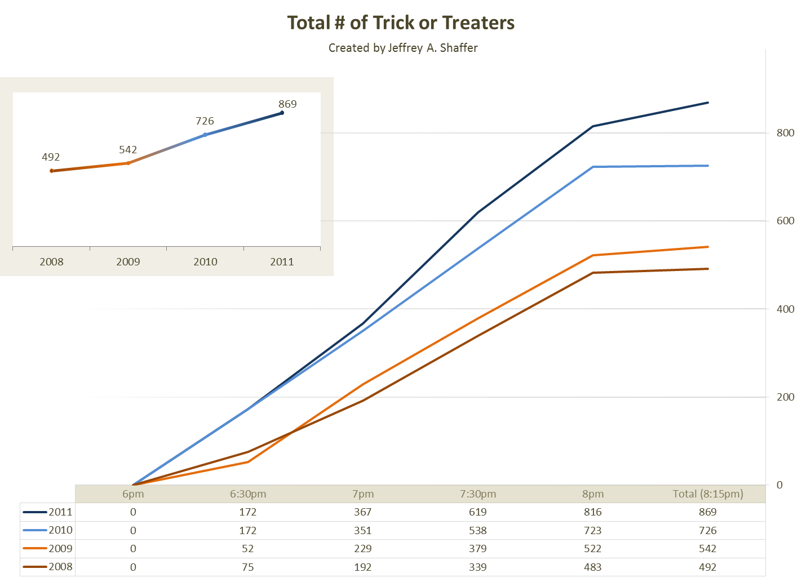
Notes:
This example was done in Excel and there is a document in the assessment folder explaining how to do this step-by-step. The large chart shows the comparison we saw in many of the previous examples, but utilizes the empty space in the top-left corner to show the executive summary. Color is consistent between charts.

Slide 55
Notes:
We can add the two distribution comparisons, time by year and year by time. Hourly temperature is added on the top right.

Slide 56
Notes:
Names of costumes could be added to provide context, but word clouds are not ideal for making precise quantitative comparisons.

Slide 57
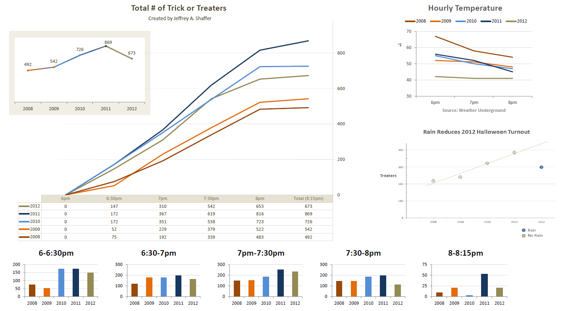
Notes:
In this example, the students visualization of rain has been added underneath the hourly temperature. This works very well in the context of this viz, but note that colors are being reused now to mean two different things. It’s always best to not resuse color to mean two different thing. In this case, a reader could be confused with blue being 2010 on all of the charts, but means rain on the scatter plot. This could be resolved by simply changing one of the blues to a different color.

Slide 58
Form Follows Function
Notes:
Alberto Cairo is the author of The Functional Art. One of the fundamental concepts in the book. Let’s look at an example of this.

Slide 59
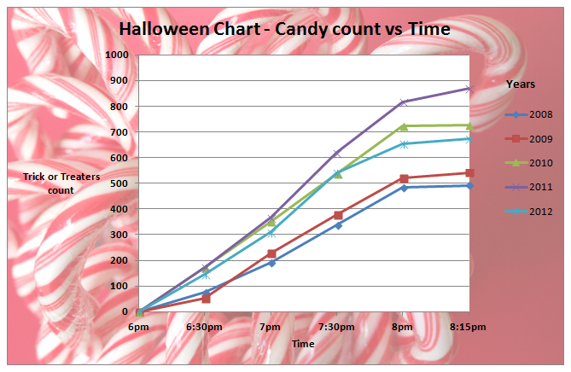
Notes:
A student created this visualization and there are lots of issues here. Instead of a showing a finished redesign, we will walk through the steps of a redesign..
1.) Markers on the line chart are different shapes.
2.) Default colors of Excel are used
3.) the color legend is plotted on a color background, but the data is plotted on a white background. Notice the light and dark blue on the lines with the white background compared to the colors in the legend.
4.) the gridlines are in increments of 100 with dark gridlines.
Let’s clean some of this up.

Slide 60
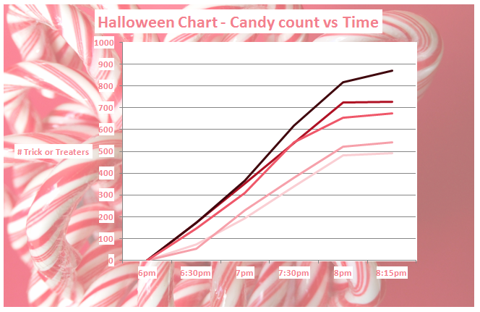
Notes:
In this example, the colors of the lines and text labels have been changed from the Excel default to colors that match the viz. This doesn’t look great though and we can’t tell which year is which without the color legend.

Slide 61
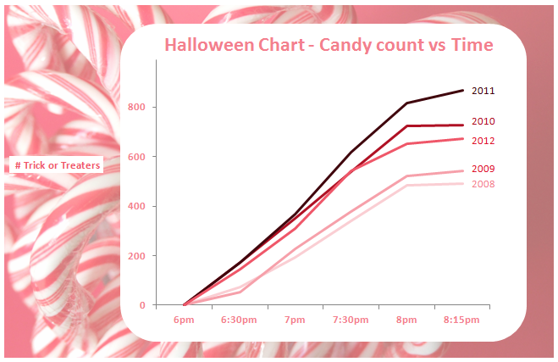
Notes:
We can move the years to labels on the line and the labels can be plotted in the chart area to make it look cleaner. This looks much better, except for the y-axis label.

Slide 62

Notes:
We can try moving it closer, or rotating it and plotting with the text, but let’s consider other alternatives.

Slide 63

Notes:
We can move the labels up to the subtitle and now it’s clear that we are showing the # of trick-or-treaters by time.
Now compare this version to the original. It’s certainly a much better design.

Slide 64
Notes:
Flip back and forth as needed to show the comparison of design.

Slide 65
Much better design now, but why candy canes for Halloween?
Notes:
The design looks great, but when it’s all done, we have to sit back and ask ourselves, why are we using candy canes, a candy typically seen at Christmas, to show data for Halloween? In this case, we have a nice design that looks good, but the message is confusing and conflicts with the fundamental function of this viz.

Slide 66
Tableau Public 2016
Notes:
In October 2016, Tableau Public promoted this dataset and encouraged people from around the world to visualize this data.

Slide 67

Notes:
Tableau Public authors joined students from all over the world and there were a number of great visualizations that were published. The hashtag on Twitter was #HalloweenViz
This viz uses a slopegraph and a treemap, along with a pumpkin dot plot.

Slide 68

Notes:
We saw a highlight table earlier showing the busiest times. In this version, the highlight table is replaced with colored dots showing the busy times. This author also looked at weather and even used Tableau’s forecast function to make a 2016 prediction.

Slide 69

Notes:
This author combined a highlight table and line chart with some great design elements to create this beautiful viz.

Slide 70

Notes:
The “Scare-board” uses two highlight tables show two different comparisons on the same dashboard along with a small multiple comparison.

Slide 71

Notes:
This author looked at the phases of the moon and plotted them in a similar way to the earlier examples we saw. The stacked bar makes the distribution of times difficult to see across the years. This would be better unstacked.

Slide 72

Notes:
This mobile friendly design shows simple sparklines along with a bar chart. Notice the use of color and the attention to detail on the labels and placement of things.

Slide 73

Notes:
You’ll notice the colors being used in these visualization. Little icons and small images add to the design elements of the visualization.

Slide 74

Notes:
Tableau Zen Master Rob Radburn’s son, Joe Radburn, was 11 at the time he created this visualization. A really great job for someone working in Tableau at such a young age, but this is another example of candy canes, associated with Christmas, being used at Halloween.

Slide 75

Notes:
This author figured out that in 2016, it was very likely that the cumulative trick-or-treaters throughout all of the years was going to hit 5,000 and created a visualization around that fact. It didn’t take long in 2016 to hit the 5,000 number.

Slide 76

Notes:
Charlie Hutcheson created this incredibly simple viz with beautiful design elements. No color, and only a single chart, showing spiders as lollipop charts upside down.

Slide 77

Notes:
And this author took the spider further, using sparklines of the years total as the legs of the spider and a data table embedded in the body of the spider.

Slide 78

Notes:
Here’s another simple design, using a line chart and bar chart.

Slide 79

Notes:
This viz has a great annotation layer on this one and the great use of weather icons to show the weather for each year.
Notice the use of area charts to show the distributions of the trick-or-treaters over time for each year.

Slide 80

Notes:
This is another example of kids getting involved in the project. Jeff’s daughter Nina created this one with Jeff’s help. She wanted bats as the markers for the line chart.

Slide 81

Notes:
Her sister Elle wanted pumpkin shapes for the lollipop charts.

Slide 82

Notes:
This is the final example, which brings function and design together into a beautiful visualization. The area chart showing the trick-or-treaters has now been turned into a ghost. Nice the simple use of color, the single chart type and grid layout. It’s actually a few simple components that have been brought together using elegant design.
By walking through all of these examples, you should have a good idea for what worked well and what didn’t. Please take these things into consideration for this week’s projects, which is to take your Halloween viz that you created and do a Makeover of that viz. Try to apply the things we learned here to your visualization to create a better design.

